Slide 1
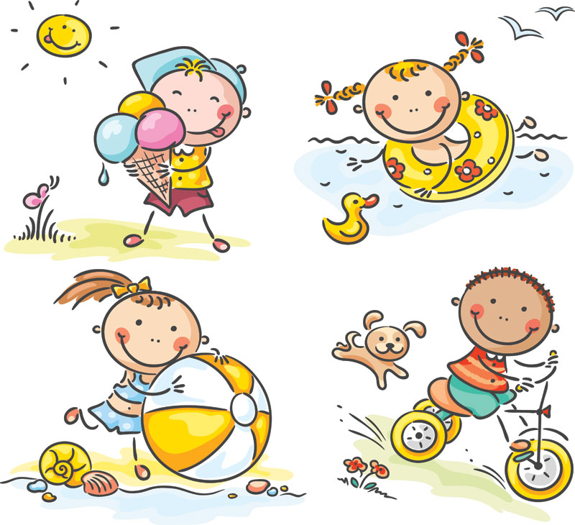
GRADE 4
UNIT TWO
My weekend
Lesson 1

Slide 5
Listen and point

Slide 6
read comics

Slide 7
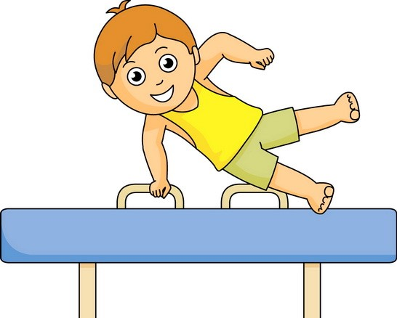
do gymnastics

Slide 8
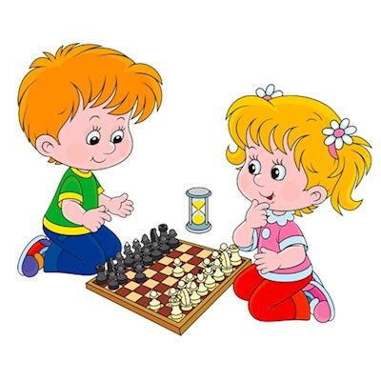
play chess

Slide 9
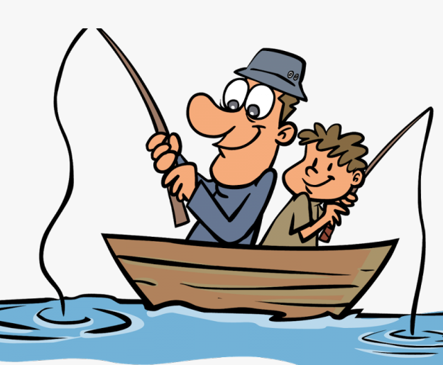
fish

Slide 10
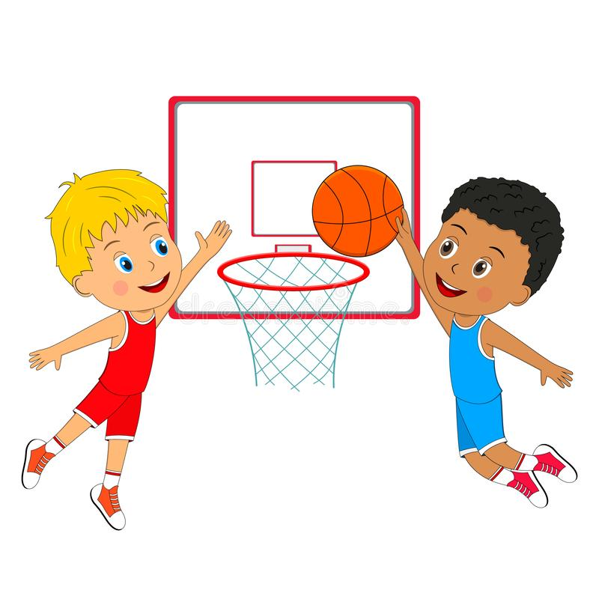
play basketball

Slide 11
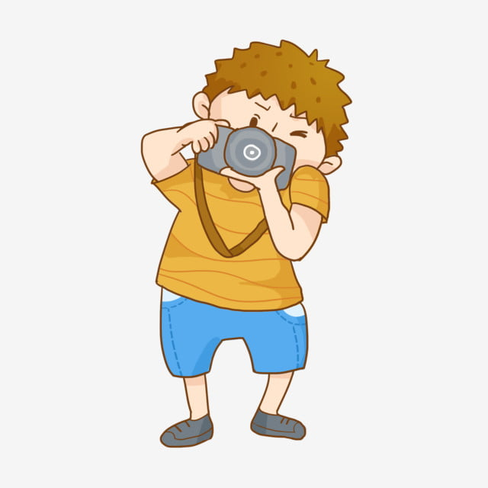
take photos

Slide 12
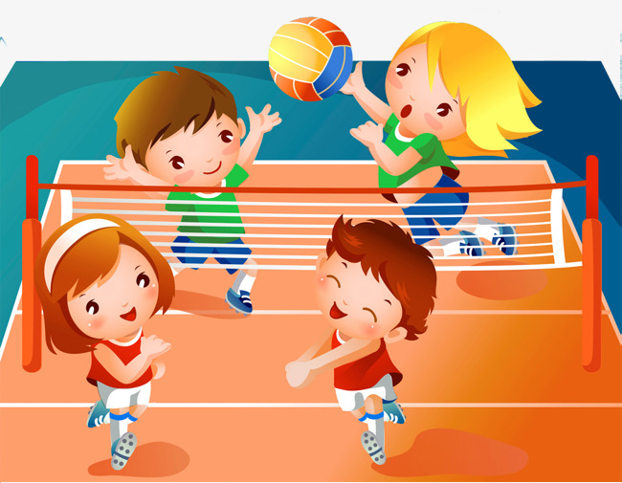
play volleyball

Slide 13
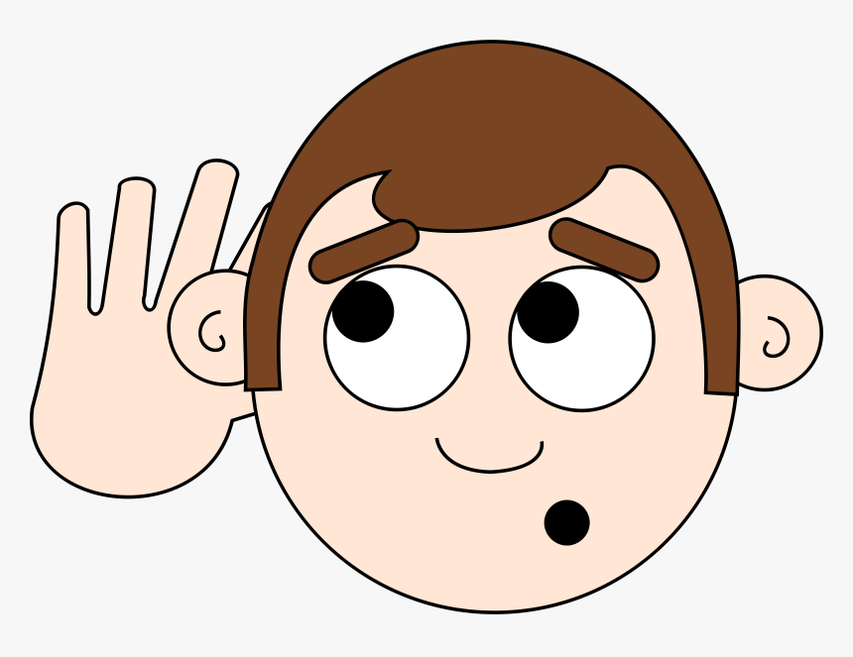
LISTEN and REPEAT

Slide 14
read comics

Slide 15
do gymnastics

Slide 16
play chess

Slide 17
fish

Slide 18
play basketball

Slide 19
take photos

Slide 20
play volleyball

Slide 21
Let’s play a game.

Slide 29
Tasks: Watch the video and answer these questions
Where are they?
What are they doing?

Slide 31
Pair work: answer these questions
Where are they?
What are they doing?

Slide 32
GROUPWORK: ROLEPLAY

Slide 33
PERFORMANCE TIME!!!!

Slide 34
Work in pairs
Draw and talk about your weekend

Slide 35
Workbook time!!!

